Slide 1


A Guide to Strategic Student Loan Repayment
Presented by Neighborhood Legal Services
Mercedees M. Rees, Esq.
November 20, 2024
Presentation to RCSD
**not intended for use as case-specific legal advice; consult a professional with any questions before acting!

Slide 2
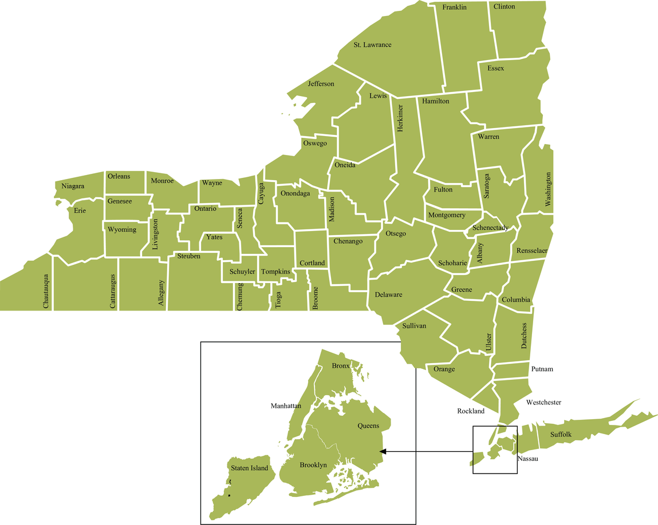

About Us
  EDCAP is a program of the Community Service Society.
  Created to help tackle the student debt crisis in NY – for everyone! No income restrictions.
  Through our Helpline and Network, we help you:
    Determine your best student loan repayment option;
    Access loan forgiveness, cancellation, and discharge programs;
    Apply for consolidation, deferment, and forbearance;
    Resolve issues with loan servicers and lenders;
    Get out of default to prevent wage garnishments, social security offsets, and tax intercepts;
    Understand financial aid offers and make a plan to go to college with less debt.
7
8
8
7
10
10
9
8
7
10
9
7
8
10
10
9
8
7
10
10
10
9
10
8
10
8
10
8
10
10
10
1
2
2
6
1
6
3
6
9
3
6
2
2
5
4
5
6
1
4
3
6
6
2
6
1
2
1
3
1
3

Slide 3

Federal Student Loan Cancellation: What’s Next?
**this PowerPoint is not intended for use as case-specific legal advice; consult a professional with any questions before you act!

Slide 4
Supreme Court decision does not impact the timing or availability of most programs
  In June 2023, the Supreme Court struck down the Biden Administration's plan to cancel up to $20,000 in student debt.
  The Biden-Harris Administration has committed to exploring cancellation under the Higher Education Act of 1965, but it will be time-consuming with an uncertain outcome.
  Other student loan programs are unaffected. Borrowers can still take advantage of these programs.
    Income Driven Repayment Forgiveness (IDRF) *
    Public Service Loan Forgiveness (PSLF)
    Total and Permanent Disability Discharge (TPD)
    Borrower Defense To Repayment (BDR)
    *more on this, later

Slide 5

5
12-Month On Ramp for Repayment
  U.S. DOE announced a 12-month “On-Ramp” period for repayment.
  Interest began accruing September 1, 2023 and payment resumption occurred October 1, 2023.
  Missed, late or partial payments will not be reported to credit agencies or cause loans to go into default until at least September 30, 2024.
  Missed payments during this period will not qualify for Public Service Loan Forgiveness (PSLF) or Income Driven Repayment Forgiveness (IDRF).
  Those enrolled in IDR plans prior to COVID should have remained enrolled in their plan at the rate they were paying previously. Such borrowers will not be required to recertify with a new income until November 1, 2024.*

Slide 6

Three Strategies for Tackling Student Debt: What’s yours?
**this PowerPoint is not intended for use as case-specific legal advice; consult a professional with any questions before you act!

Slide 7

Strategy | Description
Pay debt in full as quickly as possible | This strategy is suitable for borrowers with low loan balances or high income relative to their balance. They have the option to make lump sum payments or pay more than the required amount, regardless of the repayment plan.
Pay minimum required and pursue forgiveness, if eligible | Borrowers with high balances or low to moderate income compared to their debt can opt for this strategy. They make the minimum required payment until they become eligible for forgiveness. Making extra payments is not advisable if you expect to get forgiveness.
Pay minimum required until death do you part! | If paying off your debt or pursuing forgiveness is not a feasible option, consider paying the minimum required until you die. This strategy is often chosen by older borrowers who cannot realistically repay their loans or achieve forgiveness. Federal student loans are dischargeable upon death.
What's your strategy?
Did you know? Some repayment strategies do not involve repaying the entire balance?

Slide 8



Student Loan Repayment Checklist
**this PowerPoint is not intended for use as case-specific legal advice; consult a professional with any questions before you act!

Slide 9
1
Update your contact information with Federal Student Aid (FSA) at studentaid.gov.
  StudentAid.gov is the federal government’s national student loan database.
  If you have federal loans, you have an account. Reset your username/password if you forgot it, or create an account.
  Updating your contact information ensures you receive important communication regarding your loan status and repayment options.
Did you know? ED is working on streamlining borrower experience by creating the Next Generation Financial Services Environment (Next Gen FSA). The goal is to use FSA as a central platform to manage your loans regardless of your student loan servicer. Stay tuned!
Notes:
fsfsaf

Slide 10
2
Identify your student loan servicer and review your online account information.
  Visit your studentaid.gov account dashboard, or call FSA Information Center (800-433-3243) to find your loan servicer.
  Servicers manage your loans for the Department of Education (ED), handling payments, assisting with repayment plans, and other activities.
  40% of student loan borrowers had a servicer change since 2020.
    Navient transferred ED-owned loans to Aidvantage. If your loans are with Navient, they are FFELP or private loans.
    Great Lakes, acquired by Nelnet, is transferring accounts to Nelnet.
    OSLA stopped servicing loans and transferred its accounts to Aidvantage.
Did you know? Servicers are not your lender and some are contracted by ED to manage specific federal forgiveness programs: MOHELA manages the Public Service Loan Forgiveness and Nelnet manages Total and Permanent Disability Discharge.

Slide 11
3
Enroll in the right repayment plan.
 | Income-Driven Repayment Plans | Traditional Repayment Plans
Pros | Affordable payments based on income. Loan forgiveness after 20-25 yrs of payments. Required for other forgiveness programs. Can adjust payments when income changes. | More predictable payments. Shorter repayment period in some cases, potentially paying off loans faster. No recertification or income verification.
Cons | Annual renewal & income verification required. Potential interest accumulation over extended repayment period. Longer repayment period, extending time to become debt-free. | Higher monthly payments, potentially challenging for those with limited income. Limited flexibility in adjusting payments. No forgiveness.
Plan Names | Revised Pay As You Earn (REPAYE, soon to be SAVE) Pay As You Earn (PAYE) Income-Based Repayment (IBR) Income-Contingent Repayment (ICR) | Standard Graduated Extended
Did you know? You can enroll, recertify or change IDR plans on your own at studentaid.gov/idr. To enroll in traditional plans, contact your servicer.

Slide 12
The New IDR Plan: Saving For a Valuable Education (SAVE)
  SAVE replaced REPAYE!
  The plan (was supposed to be) implemented in 2024. The following features are already available:
    The amount of income shielded from any payment increases from 150% to 225% of the Federal Poverty Level for your household size.
    If your payment doesn't cover the interest, the excess interest won't be added to your loan. This will prevent your loan balance from increasing.
    If you are married and file your taxes separately, you can exclude your spouse's income.
  Additional benefits will be implemented in July 2024, reducing payments and bringing borrowers closer to debt elimination. Learn more here.
Did you know? You can enroll in an affordable plan like SAVE, or if your goal is to pay off your debt as quickly as possible, you can make lump sum or extra payments. There is no prepayment penalty!

Slide 13
How to Enroll in SAVE?
    If you were enrolled in REPAYE, you were automatically transitioned into SAVE, unless you consolidated during the payment pause. In that case, you will have to re-enroll.
    Eligible borrowers can switch to the SAVE plan at any time through studentaid.gov.
  Important: ONLY Direct Loans are eligible for SAVE. FFELP Loans can be consolidated for eligibility. Parent Plus loans are not considered Direct Loans for SAVE purposes. There is only one* Income Driven Repayment available for Parent Plus loans borrowers. To access that plan, Parent Plus loan borrowers must also consolidate their loans.
Did you know? For most borrowers, the SAVE plan will be the most affordable repayment plan option. But be sure to explore all repayment options to be sure.

Slide 14
Which plan is best?
Each situation is different, but here are some general rules.
  Borrowers with Direct Loans:
    IBR: This may be your best option if you are hoping to receive PSLF credit for the next coming months.
    SAVE: This may be your best option if you are hoping for the most "do-able" payment plan BUT SAVE applications are not currently being processed.
    Traditional Plans: An option if you can’t afford any IDR plan but remember there is no 20–25-year forgiveness with traditional plans.
  Borrowers with Parent Plus Loans:
    Income Contingent Repayment (ICR): Required for PSLF and IDRF. Consolidation of loans is necessary for ICR eligibility.
    Traditional Plans: May have lower payments than ICR, but no 25-year forgiveness.
  Borrowers with Non-Direct Loans (FFEL, Perkins, HEAL):
    Consolidate loans to be eligible for SAVE and additional relief options!
    Otherwise, Income Based Repayment or Traditional Plans for FFEL, Perkins and HEAL have their own (standard) repayment plan.
Did you know? The new SAVE plan is an Income Driven Repayment plan and meets the program requirement for PSLF and IDRF.

Slide 15

4
Know your payment amount and its due date
  Your servicer will send you an invoice with your monthly payment and exact due date at least 21 days before the first payment is due.
  You have the flexibility to change repayment plans and adjust your monthly due date to better suit your needs.

Slide 16
5
Be ready to make your monthly payments
  Prepare your bank account and consider enrolling in auto debit. There’s a small interest rate reduction for borrowers with auto-debit.
  If you can’t afford any payment plan, get expert advice.
  Requesting a forbearance or deferment will help postpone payments but should only be used as a short-term solution.
Did you know? You can get free credit reports weekly from Equifax, Experian and Transunion at AnnualCreditReport.com. Running your own credit report DOES NOT affect your credit score.

Slide 17
6
Escalate and get help if things go wrong
If you have issues with your student loan servicer, submit a complaint!
  FSA Ombudsman: Online Feedback Center or by calling 877-557-2575. If you are pursuing PSLF and disagree with an eligibility determination, you must file for a reconsideration within 90 days of a determination notice.
  Consumer Financial Protection Bureau (CFPB): Online or by calling (855) 411-2372, best for issues with private student loans.
  Department of Financial Services (DFS): If you live in New York, you can submit a complaint to DFS via their Consumer Complaint Portal or by calling (800) 342-3736.
Did you know? An increasing number of states are conducting student loan oversight. In New York, DFS conducts regular audits and uses complaint information to guide their audits.

Slide 18
Exploring Forgiveness, Cancellation and Discharge Options
**this PowerPoint is not intended for use as case-specific legal advice; consult a professional with any questions before you act!

Slide 19
Forgives your remaining loan balance after making payments under an Income Driven Repayment (IDR) Plan for 20-25 years. There is no employment requirement. You must be enrolled in an IDR plan.
Income Driven Repayment Forgiveness (IDRF)
The Forgiveness Programs Everyone Should Know About
Forgives your remaining loan balance after 120 qualifying payments. You must have paid on your direct loans under an Income Driven Repayment plan and at the time you made those payments you must have been working full-time (or an average of 30 hours per week) for a non-profit or government employer.
Public Service Loan Forgiveness
Discharges remaining loan balance for borrowers who were defrauded by their higher education institution. You must have attended a school that engaged in misconduct and taken out federal student loans to attend that school. Visit studentaid.gov for more info!
Borrower Defense To Repayment
Discharges remaining loan balance if you are disabled. You are considered disabled if you are receiving SSI/SSDI, have a VA rating of 100%, or have a doctor complete the physician's attestation portion of the application stating you are unable to work competitively due to your disability.
Total and Permanent Disability Discharge
Learn more at Student Loan Forgiveness Options - EDCAPNY.org

Slide 20
Public Service Loan Forgiveness Processing
  Traditionally, MOHELA was the sole servicer of loans owed by borrowers pursuing PSLF.
  Department of Education began to take on management of PSLF information.
  What this mean?
    ED did not process PSLF applications or employment verifctions from May 2024 through July 2024.
    If you were with MOHELA, your loans will remain serviced by MOHELA.
    PSLF progress are now available on studentaid.gov, only.
  What do I have to do?
    Check their work!
    If your loans were previously serviced by MOHELA, and you have a former payment count,
    double check your figures according to your previous payment count!
    If you have no payment count available, count out your months of payment manually

Slide 21
IDR Account Adjustment (IDRAA) and its Impact on IDRF and PSLF
  The IDR Account Adjustment allows more borrowers to get qualifying payment credit towards PSLF and IDRF. Through this process, borrowers may get credit for the following:
    Periods in repayment
    Time spent in forbearance of 12 consecutive or 36 cumulative months.
    Most deferments prior to 2013, economic hardship deferments after 2013.
    Months prior to loan consolidation!
    Credit will be awarded even if you were not making payments or enrolled in an IDR plan!
  Borrowers will NOT get credit for time in an in-school deferment, grace period or default (except when using Fresh Start to bring loans out of default, credit will be given for months in default during the payment pause).
  For PSLF, you must still meet the employment requirement!
Did you know? DOE is responsible for awarding credit, and borrowers will get credit between now and sometime next year! Patience is key!
Once you have Direct Loans, you will be awarded credit between now and 2024

Slide 22
Post-Adjustment IDRF Changes
  Borrowers who consolidate loans for Public Service Loan and Income Driven Repayment after the adjustments are published will be given qualifying payment credit on a weighted average basis rather than having the longest payment history applied to the entire balance.
  Borrowers consolidating Direct and/or ED-held FFELP loans for IDR Forgiveness were supposed to see discharges beginning July 1, 2024.*
  Borrowers consolidating commercially held FFELP loans will likely see little to no retroactive credit.
  Borrowers consolidating other types of non-Direct loans (Perkins, HEAL, etc.) will get no retroactive forgiveness.
  Former guidance indicated that borrowers consolidating between May 1, 2024, and June 30, 2024, could receive NO CREDIT and may risk losing all credit. THIS IS NOT THE CASE!
Once you have Direct Loans, you will be awarded credit between now and 2024

Slide 23
Post-Adjustment PSLF Considerations
  Public Service Loan Forgiveness rules changed in July 2023 to allow for retroactive credit post-consolidation. From the publishing of the adjustment on, borrowers with direct loans, only, will receive retroactive credit based on a weighted average.
  CONSOLIDATION
    The Department has issued guidance directing that borrowers submit PSLF Certification Forms for all loans, wait to get an adjusted count, THEN consolidate
  During and due to the moratorium, only borrowers who already have a PSLF count on all of their existing direct loans should have consolidated
  PSLF BUY-BACK
  Borrowers have the option to pay for months that do not count as qualifying payments for PSLF purposes, such as periods spent in deferment or forbearance while working for a qualifying employer, BUT restrictions apply
  Per FSA, you cannot buyback months prior to consolidation, but this is still developing
  In most cases, you should wait for the result of the adjustment before deciding to buy back months.

Slide 24
NYS Get on Your Feet Loan Forgiveness Program
For individuals who earned an undergraduate degree from a college/university in NY and are living in NYS; it provides up to 24 months of loan payments for eligible participants. Learn more here.
Other Forgiveness, Cancellation & Discharge Programs
Forgives up to $17,500 in federal loans for teachers who meet certain criteria, including teaching in a designated subject area or shortage area for five consecutive years. CAUTION: Time used to qualify for Teacher Loan Forgiveness cannot be used for Public Service Loan Forgiveness. If you have a high loan balance, pursuing Public Service Loan Forgiveness only may be best. Get advice before applying.
Teacher Loan Forgiveness (TLF/)
Granted to borrowers whose schools closed while they were enrolled or shortly after they withdrew and who did not complete teach outs or comparable programs elsewhere.
School Closure Discharge
Bankruptcy should be a last resort! It is not impossible, but it is difficult to discharge federal student loans in bankruptcy. You must meet the “undue hardship” test. Seek the advice of an experienced bankruptcy attorney who specializes in student loan discharge cases.
Bankruptcy
While this path might seem a bit macabre, it’s just not feasible for some borrowers to pay off their student loans, and that’s okay. Rest assured that student loans are discharged upon death and can never become another loved one’s burden.
Discharge Upon Death
Learn more at Student Loan Forgiveness Options - EDCAPNY.org

Slide 25
Fresh Start Initiative: A path for borrowers in default through 9/30/24!
  Borrowers with eligible defaulted federal student loans can bring their loans back into good standing and repair credit through an initiative called Fresh Start.
  Borrowers must take action to benefit:
    Contact your debt collector: Contact your debt collector (in most cases this will be the Default Resolution Group at 1-800-621-3115) or apply on your myeddebt.ed.gov account. Let them know you want to take advantage of Fresh Start and request that your loans be transferred to a non-default servicer and enroll in a repayment plan after which the default history will be removed from your credit reports.
    Pursue further education: If you intend to continue your education, apply for the Free Application for Federal Student Aid (FAFSA) and enroll in school at least half-time. By doing so, your loans can be transferred to a non-default servicer and placed in an in-school deferment, resulting in the removal of the default history from your credit reports.
Did you know? Borrowers who use Fresh Start to bring loans out of default will get credit towards IDRF or PSLF for months spent in default during the payment pause (from March 13, 2020).

Slide 26
What's With ALL the Asterisks?

Slide 27
5
SAVE Litigation
  This summer, a federal court issued an injunction preventing the U.S. Department of Education (ED) from implementing parts of the Saving on a Valuable Education (SAVE) Plan and other IDR plans
  Borrowers enrolled in SAVE prior to the injunction were placed in a non-interest bearing forbearance. This will not count towards PSLF or IDRF.
  Applications for SAVE that were not processed prior to the injunction are not being processed.
  Borrowers attempting to enroll in SAVE post-injunction are placed into one (1) 60-day processing forbearance, then transitioned into a litigation-specific forbearance.
  No new enrollments for ICR unless a borrower has a consolidation loan that repaid a parent PLUS loan
  IBR still open to all borrowers

Slide 28
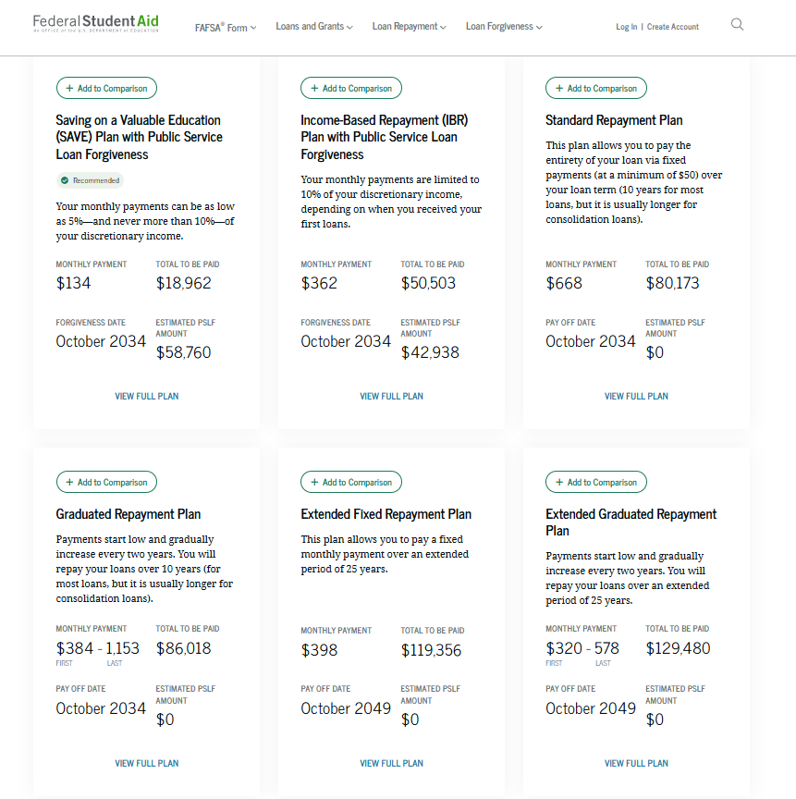
5
Based on....
Average Income of RCSD-employed teacher:
$66,000/year
Average Debt of Public School Teacher in United States:
$58,700
WHY CHOOSE SAVE AT ALL?

Slide 29
Key Dates To Know
**this PowerPoint is not intended for use as case-specific legal advice; consult a professional with any questions before you act!

Slide 30
Date | Event/Update
Summer 2023 | New Income Driven Repayment Plan (SAVE) made available. ﻿
September 2023 | Interest began accruing on federal loans.
October 2023 | Loan payments due.
December 31, 2023; April 30, 2024; June 30, 2024; September 30, 2024; ??? | Deadline to take advantage of the Income Driven Repayment (IDR) Account Adjustment.
September 30, 2024 | "On Ramp" Period Ended.
July 2024-->October 2024-->?? | IDR Account Adjustment results.
October 2024 | Fresh Start for defaulted borrowers ended.
November 1, 2024---> February 1, 2025 | Recertification Deadline for IDR borrowers enrolled prior to COVID pause.
July 2025 | Parent Plus Loophole Ends.

Slide 31
QUESTIONS??
Contact us any time!
716-847-0650 ext. 445
studentloans@nls.org
Drop-in hours:
12-4 p.m. on Thursdays
237 Main Street, Suite 400
Buffalo, NY 14203
**this PowerPoint is not intended for use as case-specific legal advice; consult a professional with any questions before you act!

Slide 32
MONROE COUNTY EDCAP
Legal Assistance of Western New York (LAWNY)
(585) 325-2520 Ext. 7087
or
(716) 373-4701 Ext. 2006
acting!https://www.lawny.org/EDCAP
EDCAP FOR ALL NEW YORKERS
https://www.edcapny.org/
**this PowerPoint is not intended for use as case-specific legal advice; consult a professional with any questions before you act!

